Slide 1
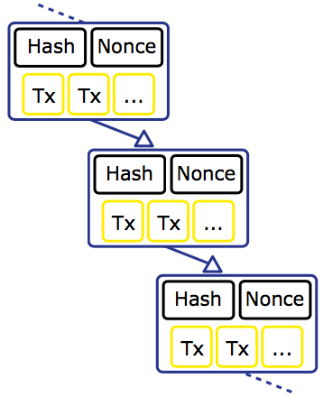
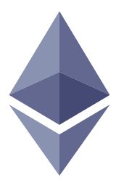

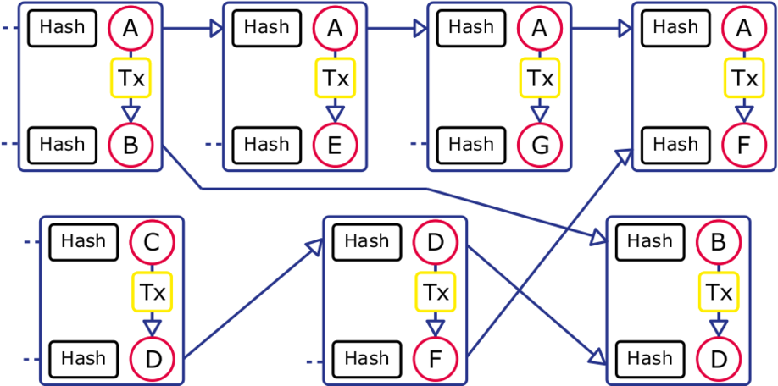
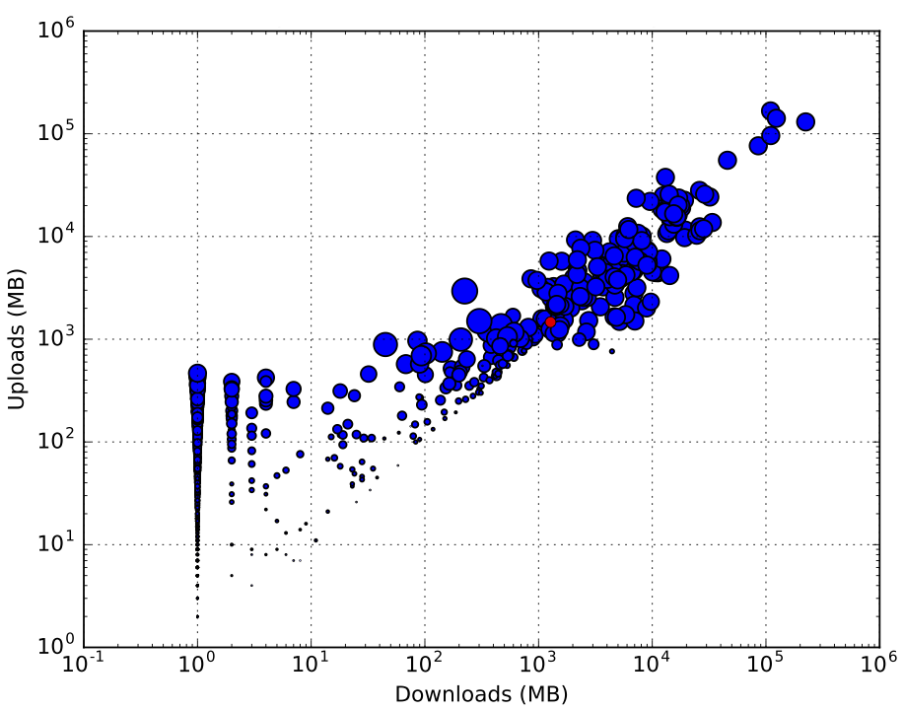
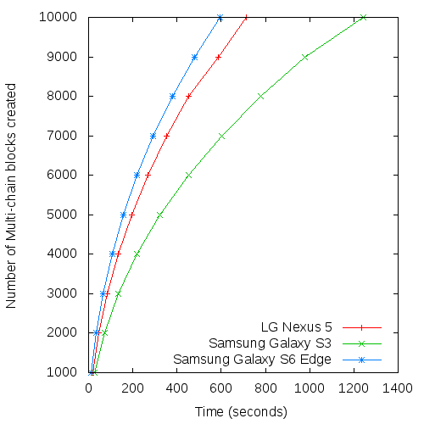


TrustChain: Building Trust with Distributed Ledgers
Martijn de Vos, Johan Pouwelse, Dick Epema
peer2peer@gmail.com
Blockchains
What is a Blockchain?
Applications
A chained data structure to store transactions.
Tamper-proof
Distributed
Each record contains a hash of the previous record
Cryptocurrency: Bitcoin, Ripple.
Distributed computing: Ethereum.
Problems
Scalability: consensus requirements limit scalability.
Bitcoin is limited to seven transactions per second.
Storage: blockchains can become very large.
Double spending: users can lie about transactions.
TrustChain
Design Specifications
TrustChain architecture with four intertwined chains
Each user maintains their own chain of records.
When performing a transactions between two peers, their chains get intertwined or “entangled”.
Computationally efficient to verify the validity of each chain.
NetFlow
Sybil-resistant reputation mechanism using the TrustChain graph as input for trust estimation.
Based on max-flow computations.
Evaluation
Free-rider Identification
Tragedy-of-the-commons experiment
Scalability experiment
Implemented TrustChain and NetFlow in Tribler, our P2P file-sharing software.
We effectively identified free-riders in our network (addressing tragedy-of-the-commons).
Scalability
Tested on Android devices.
Record creation speed is superior compared to traditional blockchain implementations.
Distributed Systems Group
www.ds.ewi.tudelft.nl
Delft University of Technology
Blockchain-lab.org

